Slide 1
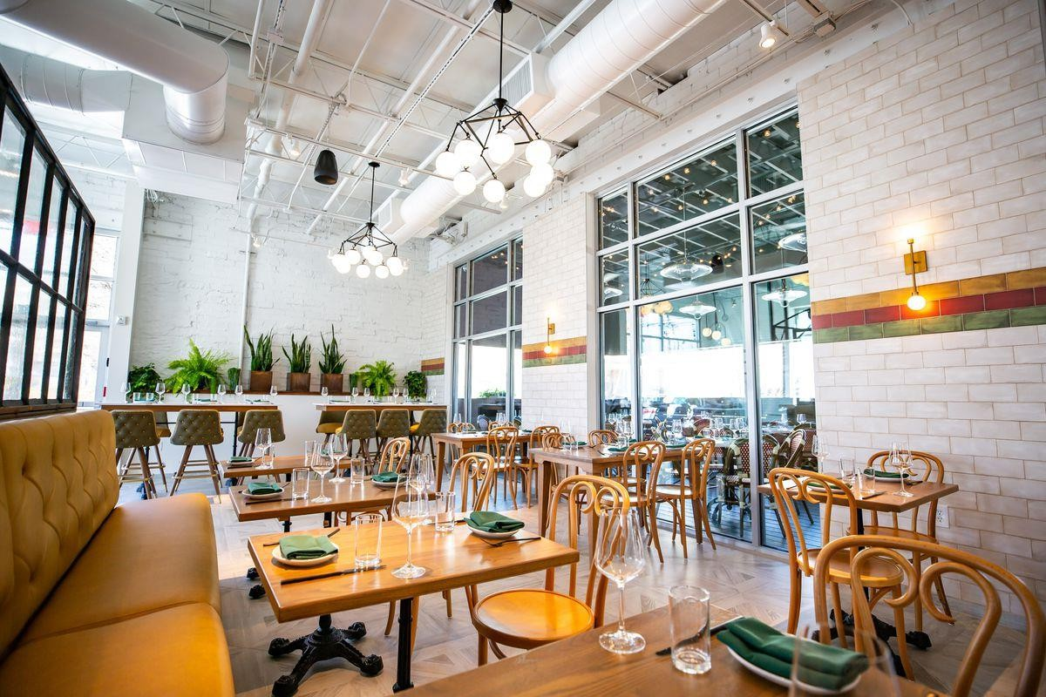
Restaurant Management System

Slide 2

GROUP MEMBERS :
SAFA WASEEM
SANIA SHABBIR
MISBAH SAEED
FIZA JABBIR

Slide 3
1. Introduction
Purpose
The purpose of this project is to design and develop a Restaurant Management System that streamlines day-to-day restaurant operations such as customer management, order placement, billing, reservations, and employee management. The system aims to reduce manual work and improve efficiency and accuracy.
Project Scope
The system will manage customer details, menu items, table reservations, order processing, bill generation, and employee records. The scope is limited to in- house restaurant operations and does not include food delivery services.

Slide 4
2. Overall Product Description
Functions
Maintain customer records.
Display menu items with prices.
Take and manage customer orders.
Generate itemized bills automatically.
Reserve tables for customers.
Manage employee data including roles and salaries.
Operating Environment
Database: Oracle 10g
Frontend : Java, PHP, or C#
Operating System: Windows or Linux
Hardware Requirements: A basic PC with 4 GB RAM and 20 GB disk space

Slide 5
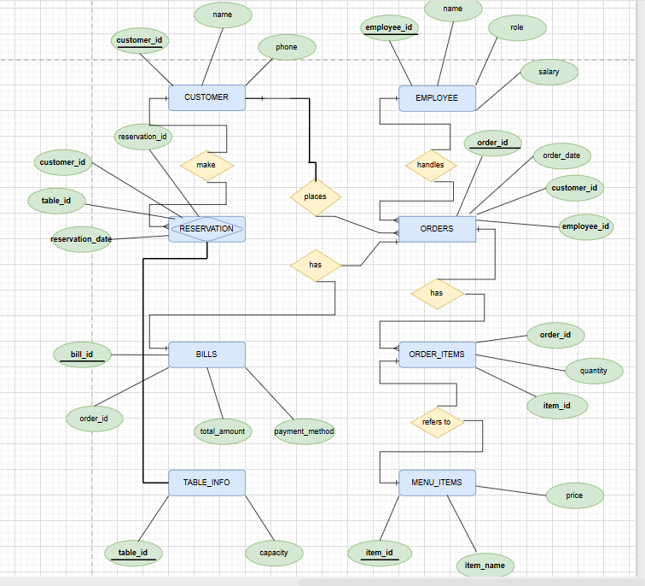
Entity Relationship Diagram

Slide 6
Implementation Constraints :
Each table will have a Primary Key (e.g., Customer_ID, Order_ID).
Foreign Keys will enforce relationships (e.g., Order.Customer_ID → Customer . Customer_ID).
Oracle-compatible data types like NUMBER, VARCHAR2, and DATE will be used

Slide 7

4. Requirements
Functional Requirements:
Manage customer orders and update kitchen
in real time
Generate bills and support multiple payment methods
Add, update, and categorize menu items.
Non-Functional Requirements:
System should respond within 2 seconds
Ensure secure login and encrypted data storage
Interface must be easy to use with minimal training

Slide 8
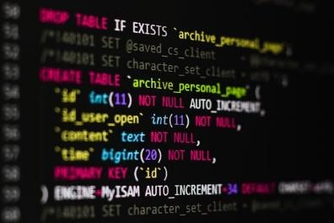
The Table Created In The Database:
Customer
Employee
Menu Item
Orders
Order_Items
Bill
Table Info
Reservation

Slide 9
TABLES:
Customer: Stores information about customers such as name, contact, and email.
Employee: Contains employee details including name, role, and contact information.
Table_Info: Holds data about restaurant tables like table number, capacity, and availability.
Menu_Items: Lists all food and drink items with name, category, and price.
Reservations: Records customer table bookings with date, time, and table reference.
Orders: Tracks orders placed by customers including customer ID, date, and total amount.
Order_Items: Links each order to the specific menu items ordered and their quantities.
Payments: Stores payment details like order ID, payment method, and amount paid.

Slide 10
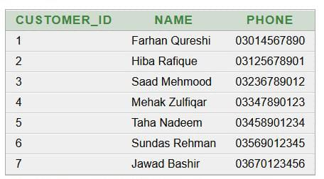
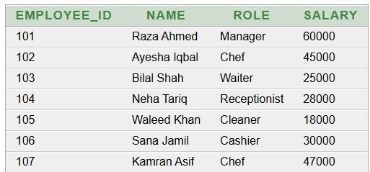
Records in tables:
Customer:
SELECT *FROM CUSTOMER
Employee:
SELECT *FROM EMPLOYEE:

Slide 11
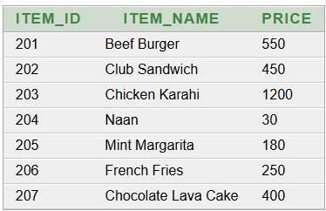
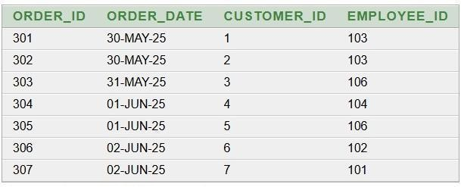
Menu_Item:
Order:
SELECT *FROM ORDER:
SELECT *FROM Menu_Item:

Slide 12
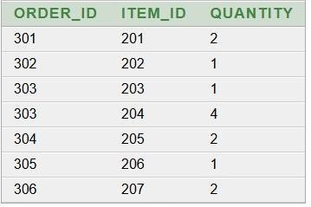
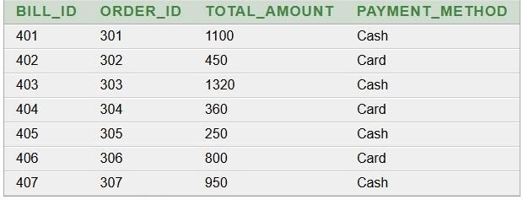
Order_Item:
SELECT *FROM Order_Item:
Bill:
SELECT *FROM BILL:

Slide 13
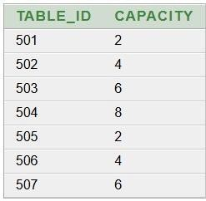
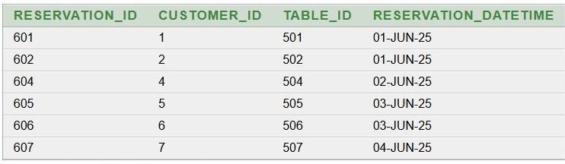
Table_Info:
SELECT *FROM Table_Info
Resevation:
SELECT *FROM Reservation

Slide 14
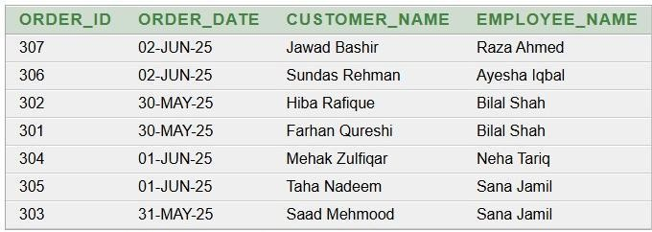
VIEWS:
Order View With Customer And Employee:
CREATE OR REPLACE VIEW Order_View AS SELECT
O.Order_ID,
O.Order_Date,
C.Name AS Employee_Name
FROM Order O
JOIN Customer C ON
O.CUSTOMER_ID=C.Customer_ID,
JOIN Employee E ON O.Employee_ID=E.Employee_ID

Slide 15
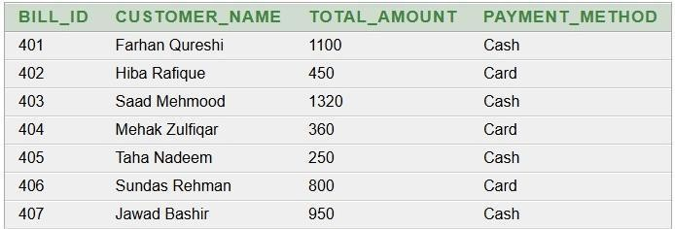
Bill View With Customer And Order:
CREATE OR REPLACE VIEW Bill_View AS SELECT B.Bill_ID,
C.Name AS Customer_Name,
B.Total_Amount,
B.Payment_Method
FROM BILL B
JOIN Order O ON B.Order_ID = O.Order_ID
JOIN Customer C ON O.Customer_id
= C.Customer_ID

Slide 16
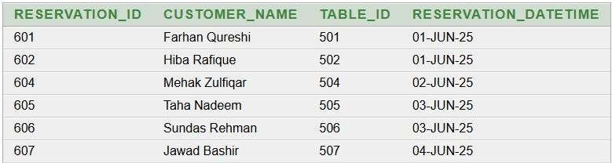
Reservation View With Customer And Table_info:
CREATE AND REPLACE VIEW
Reservation_View AS SELECT R.Reservation _ID,
C.Name AS Customer_Name,
T.Table_ID,
R.Reservation_DateTime
FROM RESERVATION R
JOIN CUSTOMER C ON
Customer_ID = C.Customer_ID
JOIN Table_Info T on R.Table_ID =
T.Table_ID

Slide 17
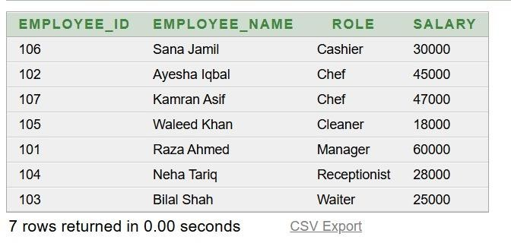
EMPLOYEE ROLE SALARY VIEW
CREATE VIEW
Employee_Role_Salary_View
AS SELECT Employee_ID,
Name AS
Employee_Name, Role,
Salary
FROM
Employee ORDER BY Role;

Slide 18
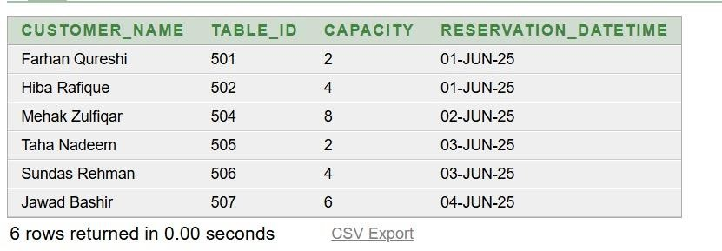
RESERVATION SCHEDULE VIEW
CREATE VIEW
Reservation_Schedule_View
AS SELECT C.Name AS
Customer_Name, T.Table_ID, T.Capacity, R.Reservation_DateTimeFROM Reservation RJOIN Customer C ON R.Customer_ID = C.Customer_IDJOIN Table_Info T ON R.Table_ID = T.Table_IDORDER BY
R.Reservation_DateTime;

Slide 19
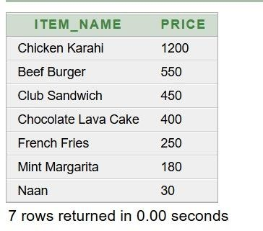
MENU ITEM PRICE VIEW
CREATE VIEW
Menu_Item_Price_View ASSELECT Item_Name, PriceFROM Menu_ItemORDER BY Price DESC;

Slide 20
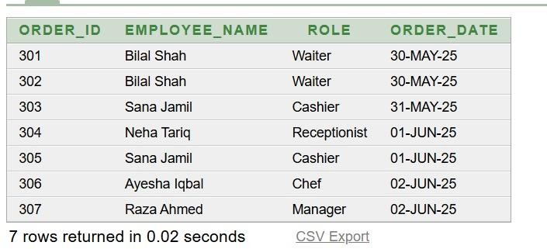
ORDER EMPLOYEE VIEW
CREATE VIEW
Order_Employee_View ASSELECT O.Order_ID,
E.Name AS Employee_Name, E.Role, O.Order_DateFROM Orders OJOIN Employee E ON O.Employee_ID = E.Employee_IDORDER BY
O.Order_Date;

Slide 21
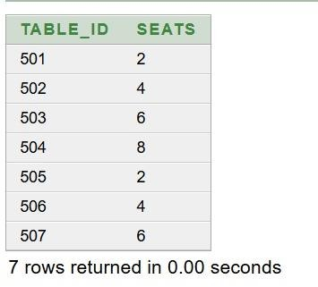
TABLE INFO VIEW
CREATE VIEW
Table_Info_Views
ASSELECT
Capacity AS SeatsFROM
Table_ID,
Table_InfoORDER BY Table_ID;
->Displays restaurant table IDs with their seating capacity

Slide 22

CONCLUSION:
The Restaurant Management System makes running a restaurant easier and more organized.
It helps staff take orders, manage tables, and handle bills quickly and correctly.
Customers get better service with faster responses and smooth
reservations.
Overall, it saves time, reduces mistakes, and keeps everything running smoothly.

Slide 23


